Slide 1


Slide 2

Structures—sometimes referred to as aggregates—are collections of related variables under one name.
Structures may contain variables of many different data types—in contrast to arrays that contain only elements of the same data type.
Structures are commonly used to define records to be stored in files (see Chapter 11, C File Processing).
Pointers and structures facilitate the formation of more complex data structures such as linked lists, queues, stacks and trees (see Chapter 12, C Data Structures).

Slide 3

Structures are derived data types—they are constructed using objects of other types.
Consider the following structure definition:
    struct card {
    char *face;
    char *suit;
    };
Keyword struct introduces the structure definition.
The identifier card is the structure tag, which names the structure definition and is used with the keyword struct to declare variables of the structure type.

Slide 4
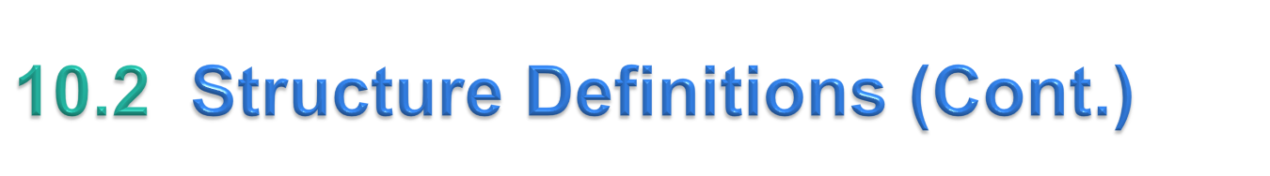
In this example, the structure type is struct card.
Variables declared within the braces of the structure definition are the structure’s members.
Members of the same structure type must have unique names, but two different structure types may contain members of the same name without conflict (we’ll soon see why).
Each structure definition must end with a semicolon.

Slide 5
The definition of struct card contains members face and suit of type char *.
Structure members can be variables of the primitive data types (e.g., int, float, etc.), or aggregates, such as arrays and other structures.
Structure members can be of many types.

Slide 6
For example, the following struct contains character array members for an employee’s first and last names, an int member for the employee’s age, a char member that would contain 'M' or 'F' for the employee’s gender and a double member for the employee’s hourly salary:,
    struct employee {
    char firstName[ 20 ];
    char lastName[ 20 ];
    int age;
    char gender;
    double hourlySalary;
    };

Slide 7
A structure cannot contain an instance of itself.
For example, a variable of type struct employee cannot be declared in the definition for struct employee.
A pointer to struct employee, however, may be included.
For example,
    struct employee2 {
    char firstName[ 20 ];
    char lastName[ 20 ];
    int age;
    char gender;
    double hourlySalary;
    struct employee2 person; /* ERROR */
    struct employee2 *ePtr; /* pointer */
    };
struct employee2 contains an instance of itself (person), which is an error.

Slide 8
Because ePtr is a pointer (to type struct employee2), it is permitted in the definition.
A structure containing a member that is a pointer to the same structure type is referred to as a self-referential structure.
Self-referential structures are used in Chapter 12 to build linked data structures.

Slide 9
Structure definitions do not reserve any space in memory; rather, each definition creates a new data type that is used to define variables.
Structure variables are defined like variables of other types.
The definition
    struct card aCard, deck[ 52 ], *cardPtr;
declares aCard to be a variable of type struct card, declares deck to be an array with 52 elements of type struct card and declares cardPtr to be a pointer to struct card.

Slide 10
Variables of a given structure type may also be declared by placing a comma-separated list of the variable names between the closing brace of the structure definition and the semicolon that ends the structure definition.
For example, the preceding definition could have been incorporated into the struct card structure definition as follows:
    struct card {
    char *face;
    char *suit;
    } aCard, deck[ 52 ], *cardPtr;

Slide 11
The structure tag name is optional.
If a structure definition does not contain a structure tag name, variables of the structure type may be declared only in the structure definition—not in a separate declaration.

Slide 12
The only valid operations that may be performed on structures are:
  assigning structure variables to structure variables of the same type,
  taking the address (&) of a structure variable,
  accessing the members of a structure variable (see Section 10.4) and
  using the sizeof operator to determine the size of a structure variable.
Structures may not be compared using operators == and !=, because structure members are not necessarily stored in consecutive bytes of memory.

Slide 13
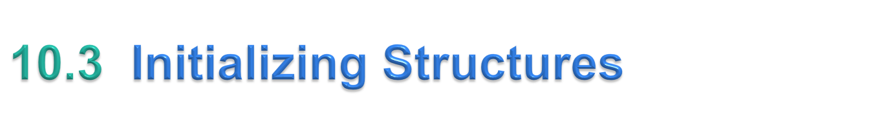
Structures can be initialized using initializer lists as with arrays.
To initialize a structure, follow the variable name in the definition with an equals sign and a brace-enclosed, comma-separated list of initializers.
For example, the declaration
    struct card aCard = { "Three", "Hearts" };
creates variable aCard to be of type struct card (as defined in Section 10.2) and initializes member face to "Three" and member suit to "Hearts".

Slide 14
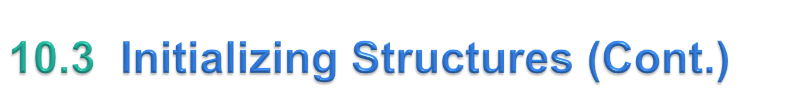
If there are fewer initializers in the list than members in the structure, the remaining members are automatically initialized to 0 (or NULL if the member is a pointer).
Structure variables defined outside a function definition (i.e., externally) are initialized to 0 or NULL if they are not explicitly initialized in the external definition.
Structure variables may also be initialized in assignment statements by assigning a structure variable of the same type, or by assigning values to the individual members of the structure.

Slide 15

Two operators are used to access members of structures: the structure member operator (.)—also called the dot operator—and the structure pointer operator (->)—also called the arrow operator.
The structure member operator accesses a structure member via the structure variable name.
For example, to print member suit of structure variable aCard defined in Section 10.3, use the statement
    printf( "%s", aCard.suit ); /* displays Hearts */

Slide 16
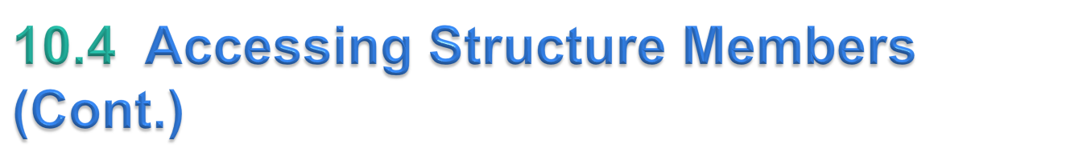
The structure pointer operator—consisting of a minus (-) sign and a greater than (>) sign with no intervening spaces—accesses a structure member via a pointer to the structure.
Assume that the pointer cardPtr has been declared to point to struct card and that the address of structure aCard has been assigned to cardPtr.
To print member suit of structure aCard with pointer cardPtr, use the statement
    printf( "%s", cardPtr->suit ); /* displays Hearts */

Slide 17
The expression cardPtr->suit is equivalent to (*cardPtr).suit, which dereferences the pointer and accesses the member suit using the structure member operator.
The parentheses are needed here because the structure member operator (.) has a higher precedence than the pointer dereferencing operator (*).
The structure pointer operator and structure member operator, along with parentheses (for calling functions) and brackets ([]) used for array subscripting, have the highest operator precedence and associate from left to right.

Slide 18
The program of Fig. 10.2 demonstrates the use of the structure member and structure pointer operators.
Using the structure member operator, the members of structure aCard are assigned the values "Ace" and "Spades", respectively (lines 18 and 19).
Pointer cardPtr is assigned the address of structure aCard (line 21).
Function printf prints the members of structure variable aCard using the structure member operator with variable name aCard, the structure pointer operator with pointer cardPtr and the structure member operator with dereferenced pointer cardPtr (lines 23 through 25).

Slide 19
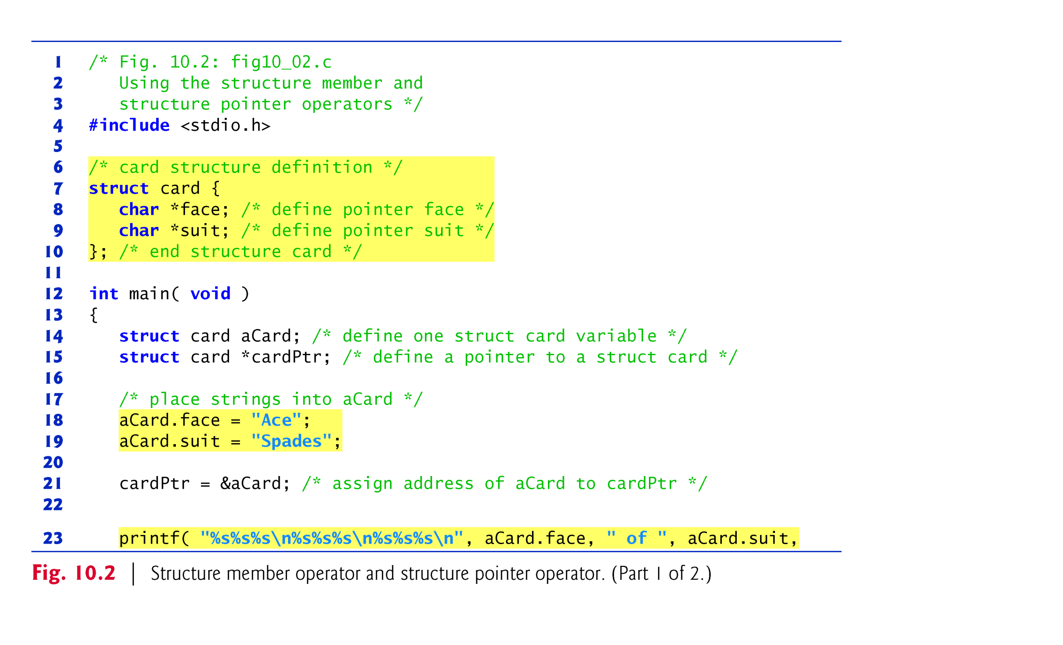

Slide 20
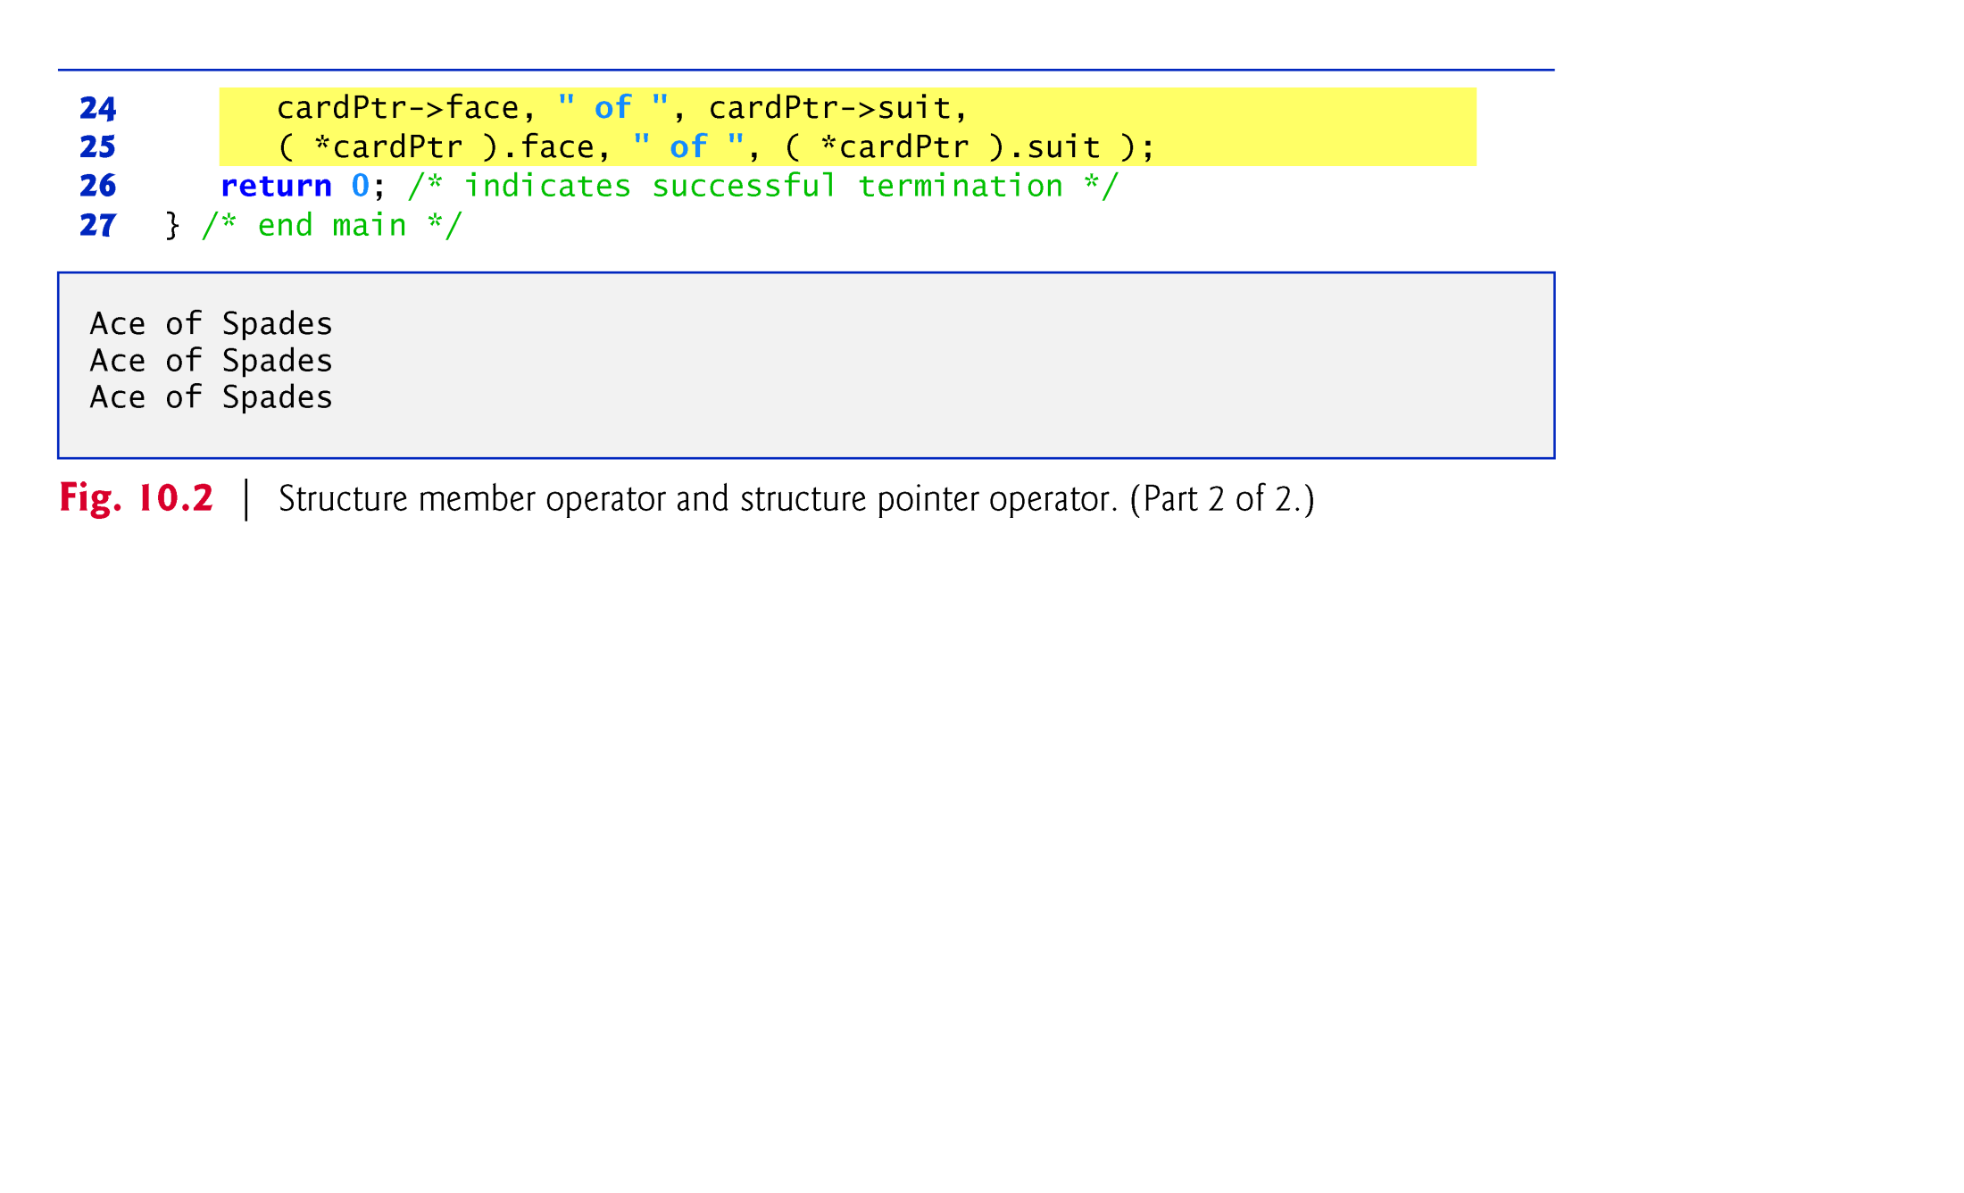

Slide 21
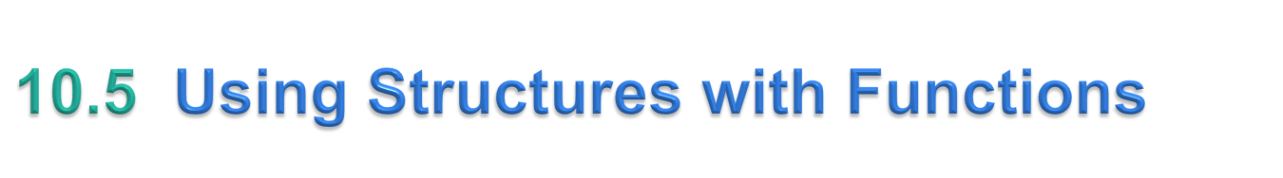
Structures may be passed to functions by passing individual structure members, by passing an entire structure or by passing a pointer to a structure.
When structures or individual structure members are passed to a function, they are passed by value.
Therefore, the members of a caller’s structure cannot be modified by the called function.
To pass a structure by reference, pass the address of the structure variable.

Slide 22
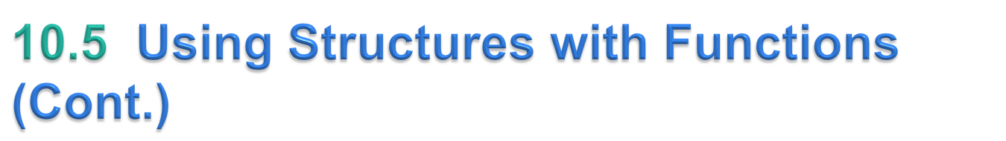
Arrays of structures—like all other arrays—are automatically passed by reference.
To pass an array by value, create a structure with the array as a member.
Structures are passed by value, so the array is passed by value.

Slide 23
#include <stdio.h>
#include <string.h>
struct student {
int id;
char name[30];
float percentage; };
int main() {
int i;
struct student record[2];
// 1st student's record
record[0].id=1;
strcpy(record[0].name, ”Fred");
record[0].percentage = 86.5;
// 2nd student's record
record[1].id=2;
strcpy(record[1].name, ”Sue");
record[1].percentage = 90.5;
// 3rd student's record
record[2].id=3;
strcpy(record[2].name, "Tom");
record[2].percentage = 81.5;
for(i=0; i<3; i++) {
printf(" Records of STUDENT : %d \n", i+1);
printf(" Id is: %d \n", record[i].id);
printf(" Name is: %s \n", record[i].name);
printf(" Percentage is: %f\n\n",record[i].percentage); }
return 0;
}

Slide 24
#include <stdio.h>
#include <string.h>
struct student
{
int id;
char name[30];
float percentage;
};
int main()
{
int i;
struct student record1 = {1, ”Fred", 90.5};
struct student record2 = {2, ”Fredericka", 93.5};
printf("Records of STUDENT1: \n");
printf(" Id is: %d \n", record1.id);
printf(" Name is: %s \n", record1.name);
printf(" Percentage is: %f \n\n", record1.percentage);
printf("Records of STUDENT2: \n");
printf(" Id is: %d \n", record2.id);
printf(" Name is: %s \n", record2.name);
printf(" Percentage is: %f \n\n", record2.percentage);
return 0;
}

Slide 25
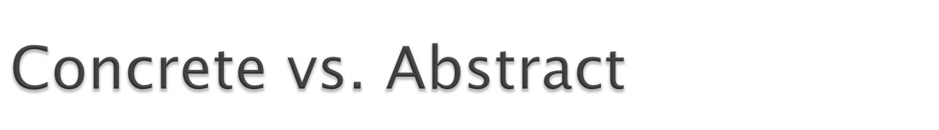
We discussed “primitive” or abstract data types in CS1050
  int, short, long, double, float, char, etc.
This is a review of the concrete data types in C to assure you know
  all of them
  how/when to use them
  which ones are “atomic” or “primitive”
  which ones are advanced and created by you

Slide 26
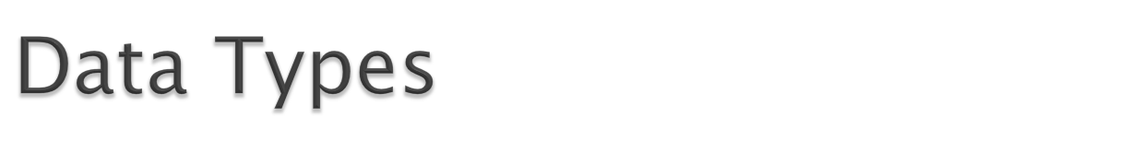
C requires all variables to be declared to constrain their contents to values of a particular data type
A “data type” has two properties
  Domain – the set of values that belong to that type. e.g. int includes all integers (. . . , -2, -1, 0, 1, 2, . . . ) and up to the limits established by the machine
  Set of Operations – the behavior of that type e.g. standard operations for int would be “addition” or “multiplication”. Other data types have a different domain and set of operations.
As we learned in CS1050 – much of the power of programming in C comes from the fact that you can define your own custom new data types

Slide 27
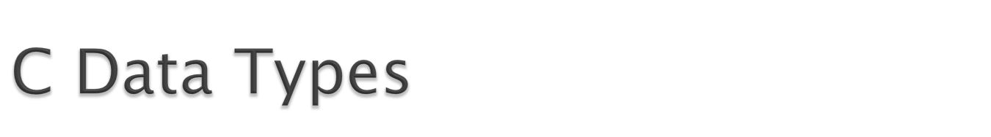
ANSI C has several fundamental types that are defined as a part of the language. These are “atomic” or “primitive” data types and are grouped into 4 categories:
  Integer (short, int, long)
  Floating-point (float, double, long double)
  Text (char, string – groups of characters)
  Boolean – (bool – TRUE or FALSE)
Most are size dependent and can only contain values up to a certain range. This WILL vary by system so be careful!

Slide 28
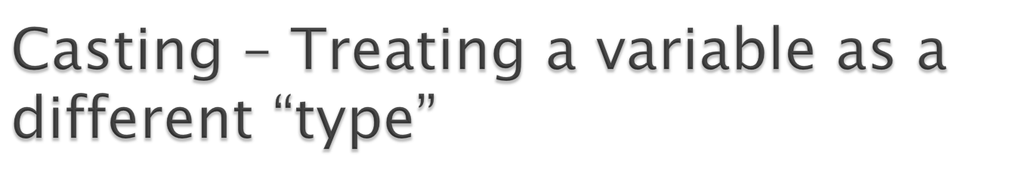
The compiler will automatically change one type of data into another if it makes sense.
Example 1: Consider the code:
  float a = 5.25;
  int b = (int)a;
  /*Explicit casting from float to int. The value of b here is 5*/
Example 2: Consider the code:
  char c = ’A’;
  int x = (int)c;
  /*Explicit casting from char to int. The value of x here is 65: the ASCII code of ‘A’*/

Slide 29
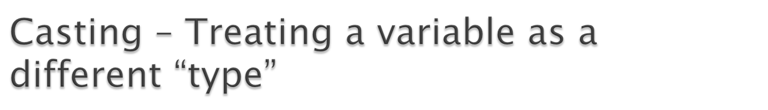
Example 3: Consider the code:
  char c;
  for(c=97; c<=122; c++)
  printf(“%c ”, c);
  This code prints:a b c d e f g h i j k l m n o p q r s t u v w x y z since 97 is the ASCII code of ‘a’, 98 is the ASCII code of ‘b’… and 122 is the ASCII code of ‘z’.
The following code is equivalent to the previous one:
  char c;
  for(c=’a’; c<=’z’; c++)
  printf(“%c ”, c);
Another equivalent code:
  int x;
  for(x=97; x<=122; x++)
  printf(“%c ”, (char)x);
  /*Explicit casting from int to char*/
A last equivalent code:
  for(x=97; x<=122; x++)
  printf(“%c ”, x);
  /*Implicit casting from int to char thanks to %c*/

Slide 30
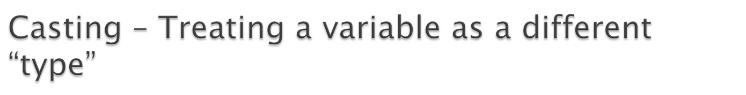
Example 4: Consider the following code:
  int x=7, y=5 ;
  float z;
  z=x/y;
  /*Here the value of z is 1*/
If we want to get the exact value of 7/5 then we need explicit casting from int to float:
  int x=7, y=5;
  float z;
  z = (float)x/(float)y;
  /*Here the value of z is 1.4*/
Again – casting is temporarily treating a variable as a different type. The compiler will make the switch and allow you the flexibility.

Slide 31
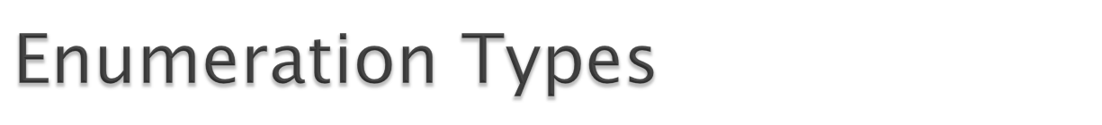
Enumeration types will look similar to some of the work we did in CS1050 – defining new “types”
With Enumeration types you create a new type in your code and you define it’s “domain”. From earlier:
  Domain – the set of values that belong to that type. e.g. int includes all integers (. . . , -2, -1, 0, 1, 2, . . . ) and up to the limits established by the machine
How is this done?
  typedef enum { element-list } name;

Slide 32
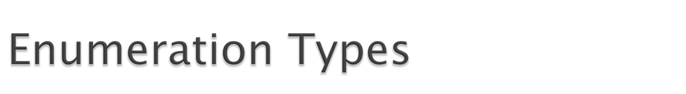
  Example 1:
  typedef enum { North, East, South, West } directionT;
    That is the DEFINITION – NOT AN INSTANCE OF “directionT”
    By doing this I now have a new “type” (int, double, char, directionT) available to program with. They all have “domains” or values that they can store. In the case of “directionT” it can only store 4 values – North, East, South, West.
    So I’ll declare a variable of type directionT; Example:
    int num1, num2;
    directionT dir;
    double fred;

Slide 33

  The values of an enumeration type are stored internally as integers.
  When the compiler encounters a new enumeration type it ordinarily assigns consecutive integers to the enumeration constants starting with integer 0.
  In the earlier example:
  typedef enum { North, East, South, West } directionT;
  the constants have the following values: North=0, East=1, South=2, West=3.
  You can control the encoding used for enumeration types by writing an equal sign and an integer constant after any of the element names:
  typdef enum {
  Penny = 1,
  Nickel = 5,
  Dime = 10,
  Quarter = 25
  } coinT;

Slide 34
    You know what enumeration types are, how to define them, how they are viewed by the compiler but what can they be used for?
    Example 1:
  typedef enum { North, East, South, West } directionT;
  directionT RightFrom(directionT dir)
  {
  return ( ( dir + 1 ) % 4 );
  }
    Example 2:
    string DirectionName (directionT dir)
    {
    switch (dir) {
    case North: return (“North”);
    case East: return (“East”);
    case West: return (“West”);
    case South: return (“South”);
    default: return (“Illegal direction value”);
    }

